Slide 1

INTERNATIONAL INSTITUTE OF INFORMATION TECHNOLOGY HINJAWADI, PUNE
GROUP NO 8
SUBMITTED BY:
Shaikh Sadiya Rafiq (Roll No. TE068)
Jadhav Tejal Sharad (Roll No. TE069)
Tehare Shreyash s (Roll No. TE070)
Syed Wilayat (Roll No. TE054)
TOPIC:
“MULTIPULE COLOR DETECTION & IMAGE TO SPEECH CONVERTOR”
GUIDED BY:
MR. PRASHANT GADAKH

Slide 2
INTRODUCTION
For colour detection:
OpenCV usually captures images and videos in 8-bit, unsigned integer, BGR format. Captured images can be considered as 3 matrices of BLUE, GREEN and RED with integer values ranges from 0 to 255. HSV color space is consists of 3 matrices, 'hue', 'saturation' and 'value'. In OpenCV value range for 'hue', 'saturation' and 'value' are respectively 0-179, 0-255 and 0-255. 'Hue' represents the color, 'saturation' represents the amount to which that respective color is mixed with white and 'value' represents the amount to which that respective color is mixed with black.
RGB color space describes colors in terms of the amount of red, green, and blue present. HSV color space describes colors in terms of the Hue, Saturation, and Value. In situations where color description plays an integral role, Sorting of objects is necessary in industries where products are manufactured on large scale. This process is simplified by automation. Our aim is to classify objects based on colour. Colour based sorting is used in many industries like crayon colour factory, agricultural machineries like rice sorter, beans sorter, peanut sorter etc.

Slide 3
IMAGE TO TEXT
For image to speech:
Machine replication of human functions like reading is an ancient dream. However, over the last five decades,machine reading has grown from a dream to reality.
Today, there are already a few systems that have some promise for coversion use, like portable bar code readers designed to help blind people identify different products in an extensive product database can enable users who are blind to access information about these products through speech and Braille. But a big limitation is that it is very hard for blind users to find the what is written in image.Speech is probably the most efficient medium for communication between humans. To extract the text from image we use optical character recognition technique(OCR) tool for python sponsored by google (Pytesseract (Python-tesseract) ).
Character recognition or optical character recognition (OCR) is the process of converting images of machine printed or handwritten text (numerals, letters, and symbols) into a computer format text. Speech synthesis is the artificial synthesis of human speech. PIL adds image processing capabilities to your Python interpreter.gTTS (Google Text-to-Speech), a Python library and CLI tool to interface with Google Translate's text-to-speech API. Write spoken mp3 data to a file, a file-like object (bytestring) for further audio manipulation, or stdout .

Slide 4
MOTIVATION
Today's human communication is primarily through speech and text. To access information in the text, a person needs a vision. However, people with visual impairments can use their hearing ability to gather information. The proposed method is camera-assisted text reading to help blind people read text labels, printed notes and text on products. The proposed project involves extracting text from the image and converting the text into a speech converter, a process that forces blind people to read text. This is the first step in creating a prototype for blind people to identify the product in the real world, where the text on the product is extracted and converted into speech.This is done using Python and GTTS (Google Text for Speech).
Colour detection is the process of detecting the name of any color.
Simple isn’t it? Well, for humans this is an extremely easy task but for computers, it is not straightforward. Human eyes and brains work together to translate light into color.
Light receptors that are present in our eyes transmit the signal to the brain. Our brain then recognizes the color. Since childhood, we have mapped certain lights with their color names.
Our goal is to convert a given text image into a string of text, saving it to a file and to hear what is written in the image through audio.
We will be using the somewhat same strategy to detect color names.

Slide 5
LITERATURE SURVEY
What is Python?
Python is an interpreter, high-level programming language for general-purapose programming by “Guido van Rossum” and first released in 1991, Python has a design philosophy that emphasizes code readability, and a syntax that allows programmers to express concepts in fewer lines of code, notably using significant whitespace. It provides constructs that enable clear programming on both small and large scales.
Python features a dynamic type system and automatic memory management. It supports multiple programming paradigms, including object-oriented, imperative, functional, procedural, and has a large and comprehensive standard library. Python interpreters are available for many operating systems. Python, the reference implementation of Python, is open source software and has a community-based development model, as do nearly all of its variant implementations. Python is managed by the non-profit Python Software Foundation.

Slide 6
.
RGB COLOUR MODEL
The RGB colour model is an additive colour model in which red, green and blue light are added together in various ways to reproduce a broad array of colours. The secondary colours of RGB model cyan, magenta and yellow, are formed by the mixture of two of the primaries and the exclusion of the third as shown in figure 1. Combination of primary colours to generate secondary colour are as follows:
1. Red + Green=Yellow
2. Green + Blue=Cyan
3. Blue + Red=Magenta
When red, green and blue are added together in equal proportion then white light is generated
HSV COLOUR MODEL
The HSV colour space has the following three components:
H – Hue (Dominant Wavelength).
S – Saturation (Purity / shades of the colour).
V – Value (Intensity).
Hue (H) defines the colour itself. Saturation (S) is the amount of gray from zero percent to 100 percent in the colour. The value (V) Component captures the amount of light falling on it thus it changes due to illumination changes.

Slide 7
Objective
COLOR DETECTION:
Computer vision is the science that means to give a comparative, if not better, capacity to a machine or PC. Computer vision is worried about the programmed extraction, investigation and comprehension of valuable data from a single picture or a grouping of pictures.
Some of the basic image processing capabilities include filtering, edge detection, corner detection, sampling and interpolation, color conversion, morphological operations, histograms and many more. Color detection using OpenCV has many advantages like, it allows the detection of a specific color in a livestream video content.
In this OpenCV color detection system there are four major modules, activated webcam, scan object, match frame parts and system results. Users can open webcam by clicking the webcam button. Then the algorithm analysis the pattern of the framed part of webcam. Pattern is matched with defined color pattern by RGB color model. If the pattern matched with the potential pattern of RGB color model then the system results with the correct output.

Slide 8
Objective
IMAGE TO SPEECH
Our aim in this project is to build a prototype system for recognition of text present in the image using OpenCV. As illustrated in the block diagram (Figure 1) the system framework consists of five functional components:
• Image acquisition
• Text extraction
• Text to speech conversion and
• Speech output.
Existing systems for text recognition are typically limited either by explicitly relying on specific shapes or colour masks or by requiring user assistance or may be of high cost. Therefore, we need a low-cost system that will be able to automatically locate and read the text aloud to visually impaired persons. The main idea of this project is to recognize the text character and convert it into mp3 file.

Slide 9
EXISTING SYSTEM
For colour detection:
•In all these existing systems color detection is performed using MATLABLIB based on RGB color model.
•RGB colour model represents colour in red(R), green (G) and blue (B) components.
•Controllers used for sorting are applications in the color detection
•In existing object sorting systems colour detection is based on RGB colour model.
•The process is performed on MATLABLIB.
•RGB colour model is a three channel model in which combination of red, green and blue defines a specific shade.
•These values changes with illumination resulting in erroneous operation
Disadvantage:
• RGB color is detected
Only single color are detecting

Slide 10
EXISTING SYSTEM
For image to speech:
The Open CV is a python library that can be used for many tasks, like color detection, face recognisation, and mask detection .
The Open CV board comes equipped with an SD card. This slot permits us to insert an SD card and that can use it as their devices. Python is the recommended programming language, but windows is its recommended operating system.
Nearly every flavour of OS that works on Raspberry Pi—Raspbian.Optical character recognition, or OCR, is a method of converting a scanned image into text.
When a page is scanned, it is typically stored as a bit-mapped file in TIF format. When the image is displayed on the screen, we can read it. But to the computer, it is just a series of black and white dots. The computer does not recognize any "words" on the image.
This is what OCR does. OCR looks at each line of the image and attempts to determine if the black and white dots represent a particular letter or number. OCR was actually developed originally to assist sight-impaired individuals gain access to printed information.
That same technology has been updated and improved and is now used to "read" computer files.

Slide 11
PROPOSED SYSTEM
For Colour detection:
•This paper proposes a system which uses low cost and open source software for achieving the goal of sorting objects.
•Proposed system uses low cost USB camera and OpenCV for sorting. OpenCV is a software library for real-time computer vision.
•OpenCV helps to analyze image and video efficiently.
•Initially colour detection was based on RGB colour model but it is not efficient as RGB colour density varies drastically for different colours.
•The proposed paper uses HSV colour model for colour detection of objects.
•Colour offers leading information about objects. Several colour models are available such as RGB colour model, CMYK colour model, HSV model. RGB model uses primary colours.
CMYK represents secondary colours Cyan(C), Magenta (M), Yellow (Y) and Black (K). In proposed method colour image is analyzed in HSV model point of view.
Advantages:
•Several colour models are available such as RGB colour model, CMYK colour model, HSV model.

Slide 12
PROPOSED SYSTEM
In this system we are using openCV for image capturing After capturing that image is stored then we fetching text from image by using Pytesseract(Python-tesseract) It is an optical character recognition (OCR) tool for python sponsored by google and storing in to file after this we are performing text to speech by using gtts(google text to image).In our proposed system no need of any hardware kit so it is low cost system.
Image Acquisition
In this step the image of the text is captured using web camera. Time require to capture image is 5 sec timer for closing capturing window press ‘Q’ and for closing camera window press ‘esc’ key .The acquired image is then applied to the image text extraction step for extracting text from image.
Text Extraction
In this step the recognized text present in the image are extracted using OCR tool. In this project, we use Pytesseract library which helps to extract the recognized text.
Text to Speech (TTS) System In this step the extracted text is first converted into speech using GTTS library
which is capable of converting text to speech. In this project the text to speech library is used for conversion of Text to speech.
Text to Speech (TTS) System
In this step the extracted text is first converted into speech using GTTS library
which is capable of converting text to speech. In this project the text to speech library is used for conversion of Text to speech.

Slide 13
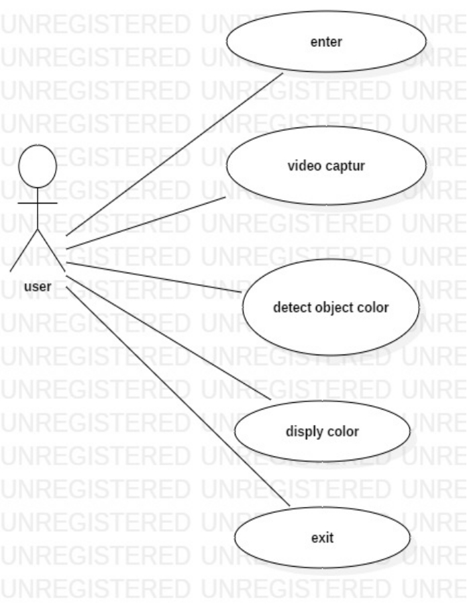
ARCHITECTURAL DESIGN
This is an Architecture dig. for colour detection.
in this user is an actor which will provide video as an action.
video will be capture by our algorithm and colour will be detected.
and displyed with the help of rectangular box in output window.

Slide 14
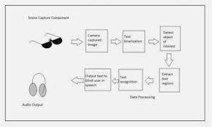
ARCHITECTURAL DESIGN
This architecture dig. for image to speech convertor.
In this system we are capturing image from video that will be provided by user.
after capturing an image we are storing that image in our system.
Then We are converting that image to text format by using algorithm.
After That text will be converted in speech format by using gTTS (google Text To Speech) convertor.
And audio file will be the output file.

Slide 15
SOFTWARE REQUIREMENT
•Programming Laguage:Python
•Version:Python3.8/9
•Library: Numpy ,OpenCV (python -library), Pytesseract(Python-tesseract), Python Imaging Library (PIL), gTTS (Google Text-to-Speech) ,pandas.
•Operating System :window 10

Slide 16
HARDWARE REQUIREMENT
The hardware requirements are:
• RAM :2GB(or)above
• Graphic card:500MB(or)above
Hard disk:2TB
camera

Slide 17
Algorithm
For colour detection:
import cv2
import numpy as np
cap = cv2.VideoCapture(0)
cap.set(3,640)
cap.set(4,480)
cap.set(10,100)
while 1:
_, img = cap.read()
hsv = cv2.cvtColor(img, cv2.COLOR_BGR2HSV)
# Red color
red_lower = np.array([136, 87, 111], np.uint8)
red_upper = np.array([180, 255, 255], np.uint8)
# Blue color
blue_lower = np.array([110,50,50], np.uint8)
blue_upper = np.array([130,255,255], np.uint8)
# yellow color
yellow_lower = np.array([22, 60, 200], np.uint8)
yellow_upper = np.array([60, 255, 255], np.uint8)

Slide 18
.
# white color
white_lower = np.array([0, 0, 200], np.uint8)
white_upper = np.array([180, 20, 255], np.uint8)
# black color
black_lower = np.array([0, 0, 0], np.uint8)
black_upper = np.array([180, 255, 30], np.uint8)
# green color
green_lower = np.array([50, 50, 50], np.uint8)
green_upper = np.array([70, 255, 255], np.uint8)
# All color together
red = cv2.inRange(hsv, red_lower, red_upper)
blue = cv2.inRange(hsv, blue_lower, blue_upper)
yellow = cv2.inRange(hsv, yellow_lower, yellow_upper)
white = cv2.inRange(hsv, white_lower, white_upper)
black = cv2.inRange(hsv, black_lower, black_upper)
green = cv2.inRange(hsv, green_lower, green_upper)
# Morphological Transform,Dilation
kernel = np.ones((10, 10), "uint8")
red = cv2.dilate(red, kernel)
res_red = cv2.bitwise_and(img, img, mask=red)

Slide 19
.
blue = cv2.dilate(blue, kernel)
res_blue = cv2.bitwise_and(img, img, mask=blue)
yellow = cv2.dilate(yellow, kernel)
res_yellow = cv2.bitwise_and(img, img, mask=yellow)
white = cv2.dilate(white, kernel)
res_white = cv2.bitwise_and(img, img, mask=white)
black = cv2.dilate(black, kernel)
res_black = cv2.bitwise_and(img, img, mask=black)
green = cv2.dilate(green, kernel)
res_green = cv2.bitwise_and(img, img, mask=green)
# Tracking red
contours, hierarchy = cv2.findContours(red, cv2.RETR_TREE, cv2.CHAIN_APPROX_SIMPLE)
for pic, contour in enumerate(contours):
area = cv2.contourArea(contour)
if area > 300:
x, y, w, h = cv2.boundingRect(contour)
img = cv2.rectangle(img, (x, y), (x + w, y + h), (0, 0, 255), 2)
cv2.putText(img, "Red Colour", (x, y), cv2.FONT_HERSHEY_SIMPLEX, 0.7, (0, 0, 255))

Slide 20
.
# Tracking blue
contours, hierarchy = cv2.findContours(blue, cv2.RETR_TREE, cv2.CHAIN_APPROX_SIMPLE)
for pic, contour in enumerate(contours):
area = cv2.contourArea(contour)
if area > 300:
x, y, w, h = cv2.boundingRect(contour)
img = cv2.rectangle(img, (x, y), (x + w, y + h), (255, 0, 0), 2)
cv2.putText(img, "Blue Colour", (x, y), cv2.FONT_HERSHEY_SIMPLEX,0.7, (255, 0, 0),1)
# Tracking yellow
contours, hierarchy = cv2.findContours(yellow, cv2.RETR_TREE, cv2.CHAIN_APPROX_SIMPLE)
for pic, contour in enumerate(contours):
area = cv2.contourArea(contour)
if area > 300:
x, y, w, h = cv2.boundingRect(contour)
img = cv2.rectangle(img, (x, y), (x + w, y + h), (70, 255, 255), 2)
cv2.putText(img, "Yellow Colour", (x, y), cv2.FONT_HERSHEY_SIMPLEX, 0.1, (70, 255, 255))
# Tracking white
contours, hierarchy = cv2.findContours(white, cv2.RETR_TREE, cv2.CHAIN_APPROX_SIMPLE)
for pic, contour in enumerate(contours):
area = cv2.contourArea(contour)
if area > 300:
x, y, w, h = cv2.boundingRect(contour)
img = cv2.rectangle(img, (x, y), (x + w, y + h), (255, 255, 255), 2)
cv2.putText(img, "White Colour", (x, y), cv2.FONT_HERSHEY_SIMPLEX, 0.1, (255, 255, 255))

Slide 21
.
# Tracking black
contours, hierarchy = cv2.findContours(black, cv2.RETR_TREE, cv2.CHAIN_APPROX_SIMPLE)
for pic, contour in enumerate(contours):
area = cv2.contourArea(contour)
if area > 300:
x, y, w, h = cv2.boundingRect(contour)
img = cv2.rectangle(img, (x, y), (x + w, y + h), (0, 0, 0), 2)
cv2.putText(img, "Black Colour", (x, y), cv2.FONT_HERSHEY_SIMPLEX, 0.7, (0, 0, 0))
# Tracking green
contours, hierarchy = cv2.findContours(green, cv2.RETR_TREE, cv2.CHAIN_APPROX_SIMPLE)
for pic, contour in enumerate(contours):
area = cv2.contourArea(contour)
if area > 300:
x, y, w, h = cv2.boundingRect(contour)
img = cv2.rectangle(img, (x, y), (x + w, y + h), (0, 255, 0), 2)
cv2.putText(img, "Green Colour", (x, y), cv2.FONT_HERSHEY_SIMPLEX, 0.7, (0, 255, 0))
cv2.imshow("Color Tracking", img)
if cv2.waitKey(10) & 0xFF == ord('q'):
cap.release()
cv2.destroyAllWindows()
break

Slide 22
.
For image capturing:
import cv2
import time
# SET THE COUNTDOWN TIMER
# for simplicity we set it to 3
# We can also take this as input
TIMER = int(5)
# Open the camera
cap = cv2.VideoCapture(0)
cap.set(3,640)
cap.set(4,480)
cap.set(10,100)
while True:
# Read and display each frame
ret, img = cap.read()
cv2.imshow('a', img)
# check for the key pressed
k = cv2.waitKey(125)

Slide 23
# set the key for the countdown
# to begin. Here we set q
# if key pressed is q
if k == ord('q'):
prev = time.time()
while TIMER >= 0:
ret, img = cap.read()
# Display countdown on each frame
# specify the font and draw the
# countdown using puttext
font = cv2.FONT_HERSHEY_SIMPLEX
cv2.putText(img, str(TIMER),
(200, 250), font,
7, (0, 255, 255),
4, cv2.LINE_AA)
cv2.imshow('Taking Image', img)
cv2.waitKey(125)
# current time
cur = time.time()
# Update and keep track of Countdown
# if time elapsed is one second
# than decrese the counter
if cur - prev >= 1:
prev = cur
TIMER = TIMER - 1

Slide 24
.
else:
ret, img = cap.read()
# Display the clicked frame for 2
# sec.You can increase time in
# waitKey also
cv2.imshow('Taking photo', img)
# time for which image displayed
cv2.waitKey(2000)
# Save the frame
cv2.imwrite('camera.jpg', img)
# HERE we can reset the Countdown timer
# if we want more Capture without closing
# the camera
# Press Esc to exit
elif k == 27:
break
# close the camera
cap.release()
# close all the opened windows
cv2.destroyAllWindows()

Slide 25
.
For Image To Speech:
from gtts import gTTS
import os
import pytesseract as tess
from PIL import Image
tess.pytesseract.tesseract_cmd = r'C:\Users\sadiya rafiq\AppData\Local\Tesseract-OCR\tesseract.exe'
img = Image.open('camera.jpg')
mytext1 = tess.image_to_string(img)
with open('abc.txt', mode='w') as file:
file.write(mytext1)
print(mytext1)
# Language we want to use
language = 'en'
myobj = gTTS(text=mytext1, lang=language, slow=False)
myobj.save("output.mp3")
# Play the converted file
os.system("start output.mp3")

Slide 26
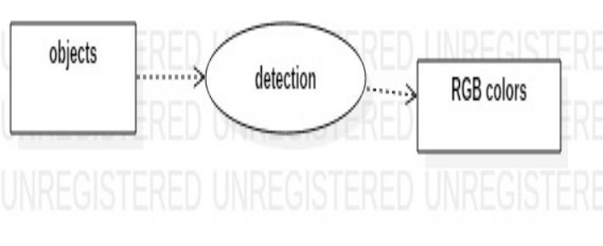
1.Context level diagram:
This level shows the overall context of the system and its operating environment and shows the whole system as just one process user register into the application and then and then get the response the entire application is installed on the mobile.

Slide 27
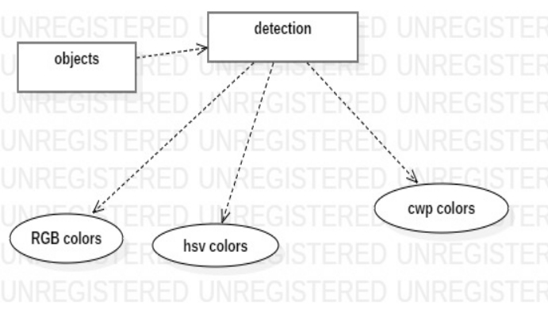
2. Top level diagram:
This level (level 1) shows all processes at the first level of numbering, data stores, external entities and the data flows between them. The purpose of this level is to show the major high-level processes of the system and their interrelation. A process model will have one and only one level-1 diagram. A level -1 diagram must be balanced with its parent context level diagram.

Slide 28
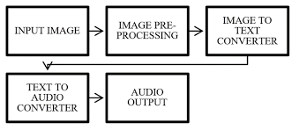
DFD
.

Slide 29
MATHEMATICAL MODEL
Numpy Module
Numpy, which stands for Numerical Python, is a library consisting of multidimensional array objects and a collection of routines for processing those arrays. Using Numpy, mathematical and logical operations on arrays can be performed. This tutorial explains the basics of Numpy such as its architecture and environment. It also discusses the various array functions, types of indexing, etc. An introduction to Matplotlib is also provided. All this is explained with the help of examples for better understanding.
Numpy is a Python package. It stands for 'Numerical Python'. It is a library consisting of multidimensional array objects and a collection of routines for processing of array. Numeric, the
ancestor of Numpy, was developed by Jim Hamelin. Another package Numara was also devel
having some additional functionality. In 2005, Travis Oliphant created Numpy package by incorporating the features of Numara into Numeric package
The Python programming language was not initially designed for numerical computing, but attracted the attention of the scientific and engineering community early on, so that a special interest group called matrix-sig was founded in 1995 with the aim of defining an array computing package. Among its members was Python designer and maintainer Guido van Rossum, who implemented extensions to Python's syntax (in particular the indexing syntax) to make array computing easier.

Slide 30
.
Operations using Numpy
Using Numpy, a developer can perform the following operations −
Mathematical and logical operations on arrays.
Fourier transforms and routines for shape manipulation.
Operations related to linear algebra. Numpy has in-built functions for linear algebra and random
number generation.
Arrays
A Numpy array is a grid of values, all of the same type, and is indexed by a tuple of nonnegative
integers. The number of dimensions is the rank of the array; the shape of an array is a tuple of integers giving the size of the array along each dimension.
Every Numpy array is a grid of elements of the same type. Numpy provides a large set of numeric
datatypes that you can use to construct arrays. Numpy tries to guess a datatype when you create an array, but functions that construct arrays usually also include an optional argument to explicitly specify the datatype.

Slide 31
APPLICATIONS
It is useful for blind person
multipule colour detection.
due to this various images throughout the book are leftuncaptured.Hence the audiobook doesn’t involve anydiagrams or images present in the book.
Only one image can be uploaded, so if there are morepages the end user needs to upload them one by one which consumes more time.
The product provides an Optical Character Recognizer tool so for instance it is only able to capture textual data, due to this various images throughout the book are left uncaptured.Hence the audiobook doesn’t involve any diagrams or images present in the book

Slide 32
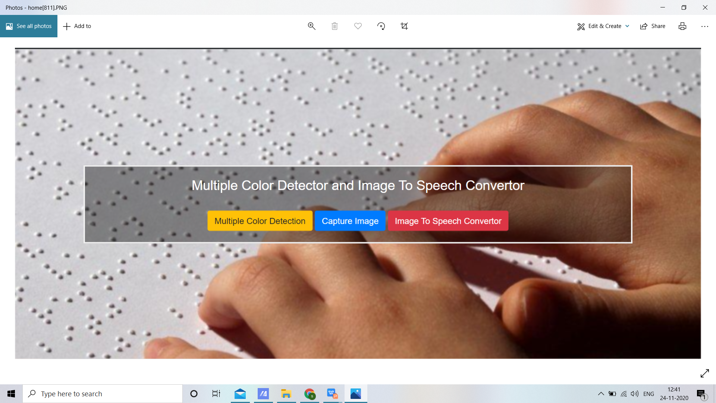
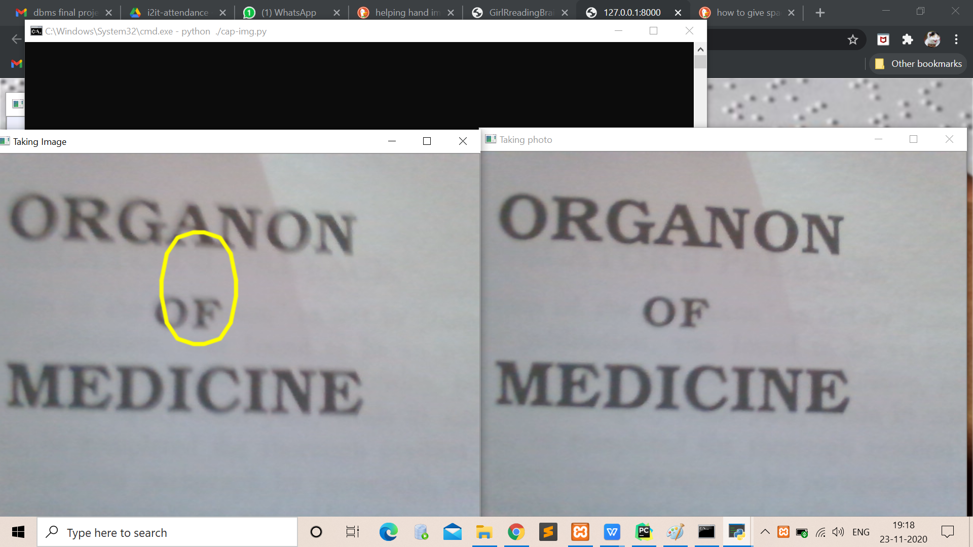
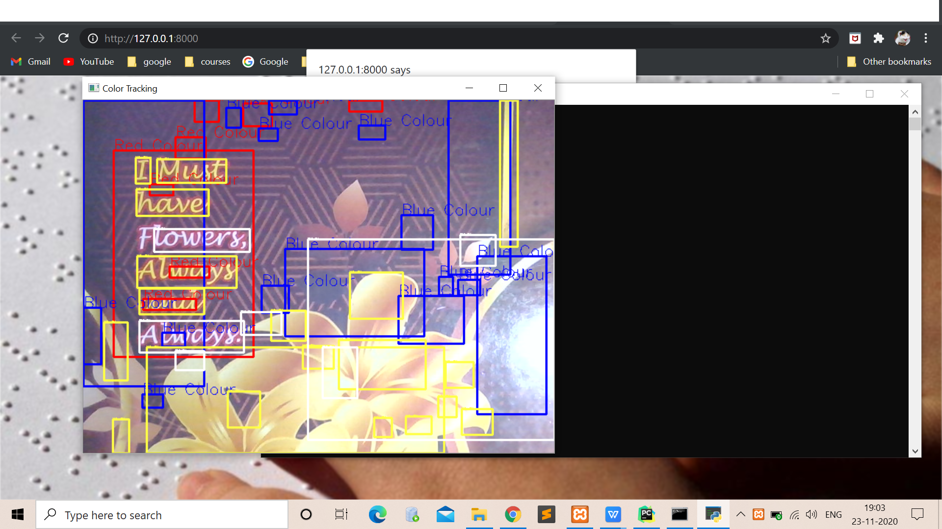
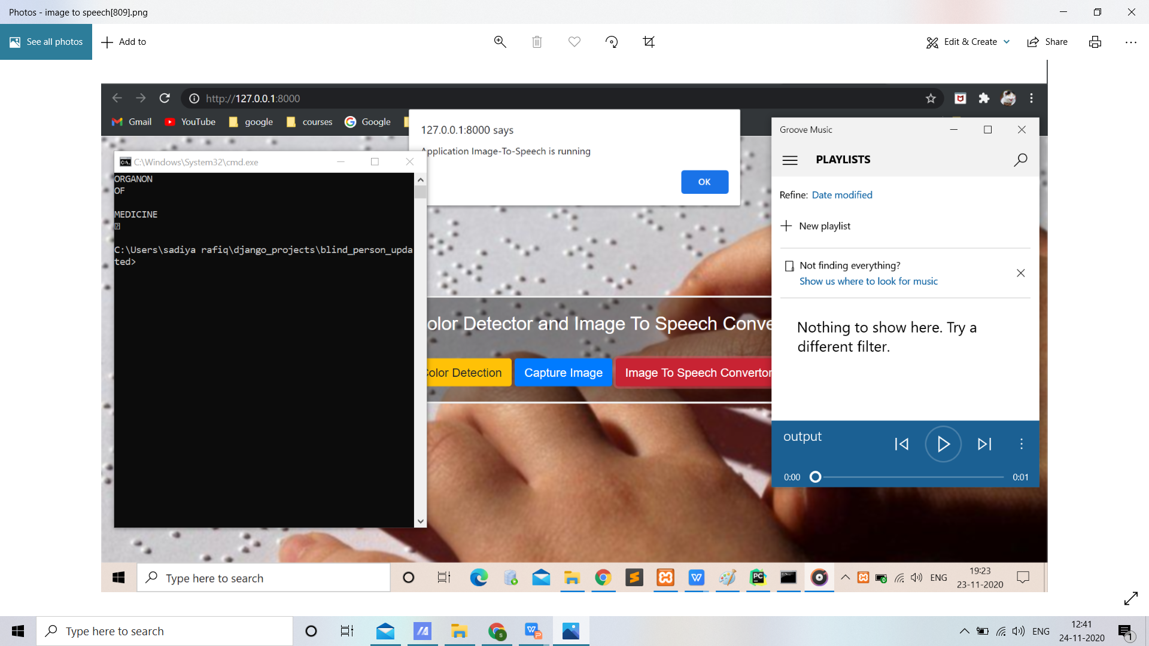
RESULT

Slide 33
CONCLUSION
For colour detection:
In particular, the focus was on the following important issues: (1) color invariance, (2) combining derivatives, (3) fusion of color models, (4) color saliency boosting, and (5) classifying image structures. To this end, the dichromatic reflection model has been outlined first. The dichromatic reflection model explains the RGB-values variations due to the image formation process. From the model, various color models are obtained showing a certain amount of invariance. Then, color (invariant) derivatives have been discussed. These derivatives include quasi-invariants which have proper noise and stability characteristics. To combine color derivatives into a single outcome, the color tensor has been used instead of taking themsum or Euclidean distance.
Tensors are convenient to describe color derivative vectors. Based on the color tensor, various image feature detection methods have been introduced to extract locale image structures such as edges, corners and circles. The experimental results of Canny color edge detection for several photometric quasi-invariants showed stable and accurate edge detection. Further, a proper model has been discussed to 24 Color Image Processing: Emerging Applications select and weight color (invariant) models for discriminatory and robust image feature detection. The use of the fusion model is important as there are many color invariant models available. In addition, we used color to express saliency. It has been shown that after color saliency boosting, (less interesting) black and white structures in the image are ignored and more interesting color structures have been detected. Finally, a classification framework has been outlined to detect and classify local image structures based on photometrical and geometrical information. High classification accuracy is obtained by simple learning strategies.
In conclusion, this chapter provides a survey on methods solving important issues in the field of color feature detection. We hope that these solutions on low-level image feature detection will aid the continuing challenging task of handling higher level computer vision task such as object recognition and tracking.
For Image To Speech:
For the first stage project presentation, the required research work has been completed and the validation of project has been proved.
The proposed system ensures to read text present in the image for assisting blind persons. Pre-processing part ensures efficient foreground extraction, which possess the required text region to be analysed.
But the system fails to extract the foreground when they possess a complex background and small text size. An improved algorithm for background subtraction can reduce the effects of complex backgrounds. The extracted text is then given to a spell corrector as OCR output is not perfect. After getting the corrected output we send it to the TTS engine which provides a speech output. . The future work will be concentrated on developing an efficient portable product that can extract text from any image enabling the blind people to read text present on the products, banners, books etc.

Slide 34
FUTURE SCOPE
Imaging can be defined as the representation of an objects external form. That definition no longer holds true. More information within an image can be considered. Fluorescent tags, mechanical-biological parameters, internal structures are some of the recent additions.
The product provides an Optical Character Recognizer tool so for instance it is only able to capture textual data,
due to this various images throughout the book are left uncaptured.Hence the audiobook doesn’t involve anydiagrams or images present in the book.
Only one image can be uploaded, so if there are morepages the end user needs to upload them one by one which consumes more time.
The product provides an Optical Character Recognizer tool so for instance it is only able to capture textual data, due to this various images throughout the book are left uncaptured.Hence the audiobook doesn’t involve any diagrams or images present in the book

Slide 35
REFERENCES
[1] Portable Camera Based Assistive Text and Product Label Reading From Hand-Held Objects For Blind Persons. Chucai Yi, Student Member IEEE, Yingli Tian, Senior Member, IEEE, and Aries Arditi .
[2] Digital Image Processing, 3rd edition, Rafael C Gonzalez, Richard E Woods.
[3] “Text Pre-processing and Text Segmentation for OCR. International Journal of Computer Science Engineering and Technology”, ARCHANA A. SHINDE, D. pp. 810- 812, 2012.
[4] ”Optical Character Recognition" International Journal of Recent Technology and Engineering (IJRTE)”, R. Mithe, S. Indalkar and N. Divekar. ISSN: 2277- 3878,Volume- 2, Issue-1, March 2013.
[5] "High quality text-to-speech synthesis: a comparison of four candidate algorithms," Acoustics, Speech, and
[6]Ajantha Devi and S Santhosh Baboo, "Optical Character Recognition on Tamil Text Image Using Raspberry Pi", International Journal of Computer Science Trends and Technology (IJCST), vol. 2, no. 4, Jul–Aug 2014.
[7]Raja Venkatesan T, M. Karthigaa, P. Ranjith, C. Arunkumar and M. Gowtham, "Intelligent Transalate System for Visually Challenged People", International Journal for Scientific Research & Development (IJSRD), vol. 3, no. 12, 2016, ISSN 2321-0613.

